Slide 1
Updates…

Slide 2
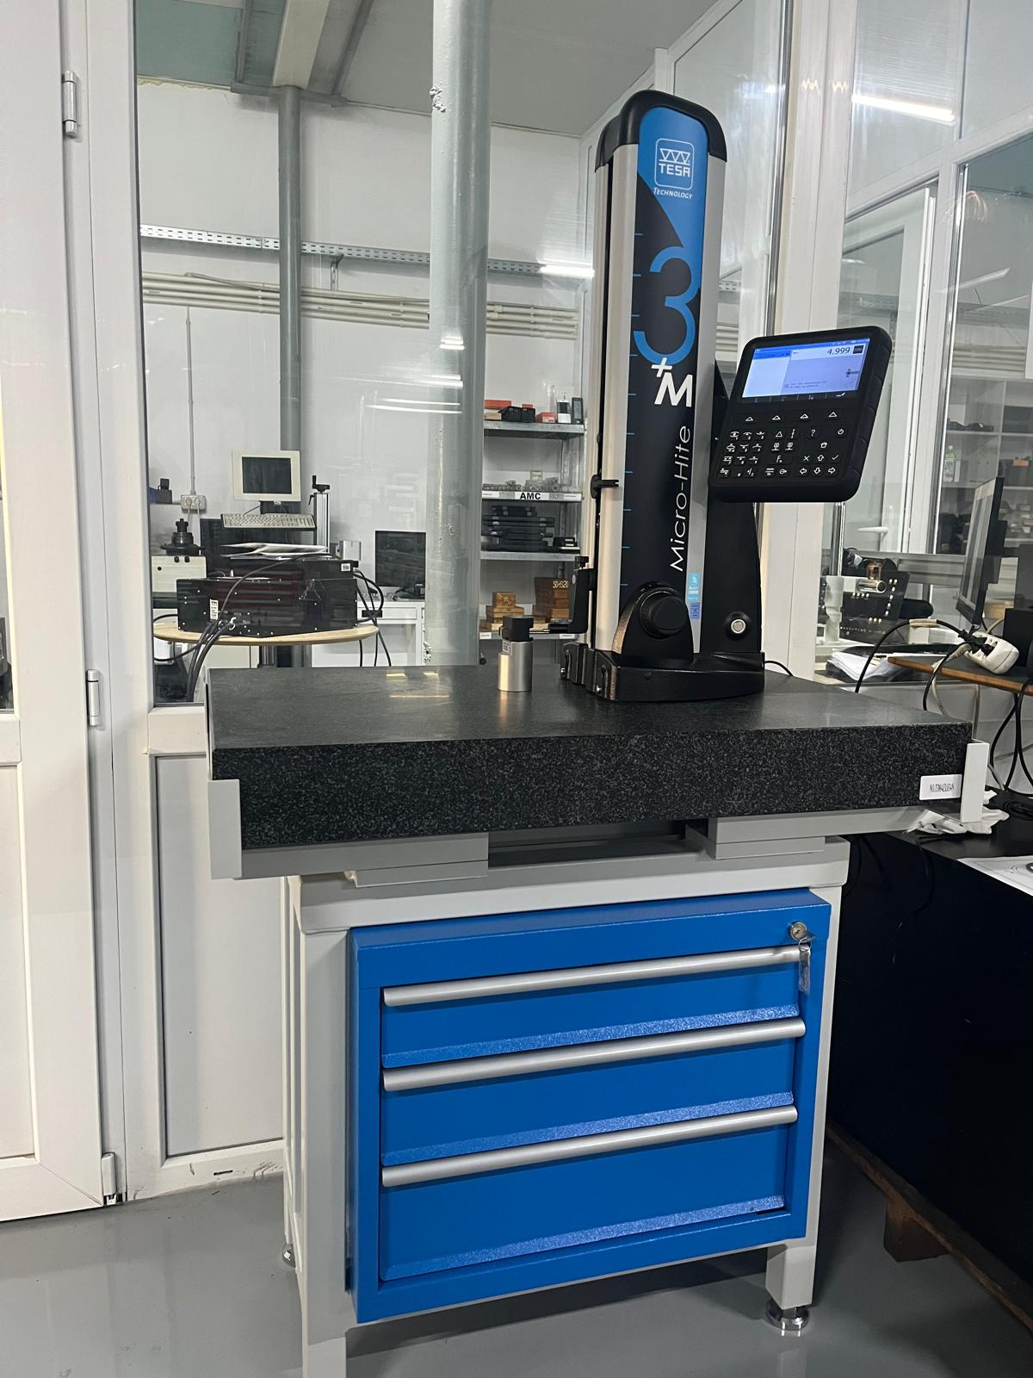

Tesa Technology height gauge
Micro – Hite 3 +M
Measuring range - 350 mm
Permissible error (L = measuring length in mm) - 1.8 + 2L / 1000 µm
Repeat accuracy (plane) - ≤0.5 µm
Repeat accuracy (bore) - ≤1 µm
Deviation from squareness (frontal) - 7 µm

Slide 3
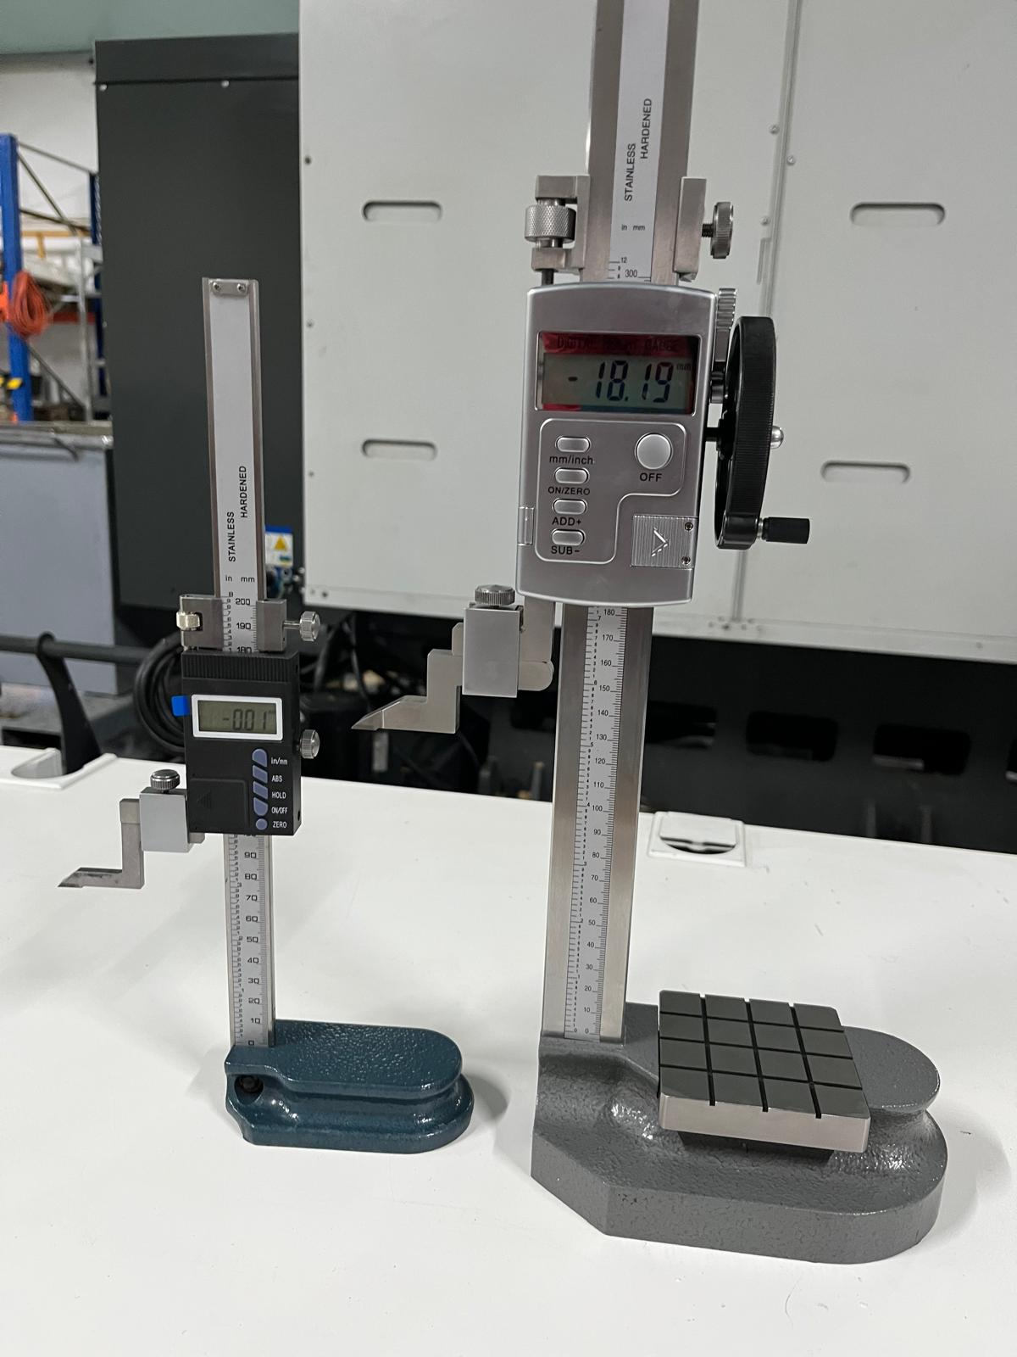

Digital height gauge, Schut 0 - 200 mm / 0.01 mm
Digital height and scribing caliper 0-300/0.01mm, with vertical feed wheel and measuring table, Klass

Slide 4
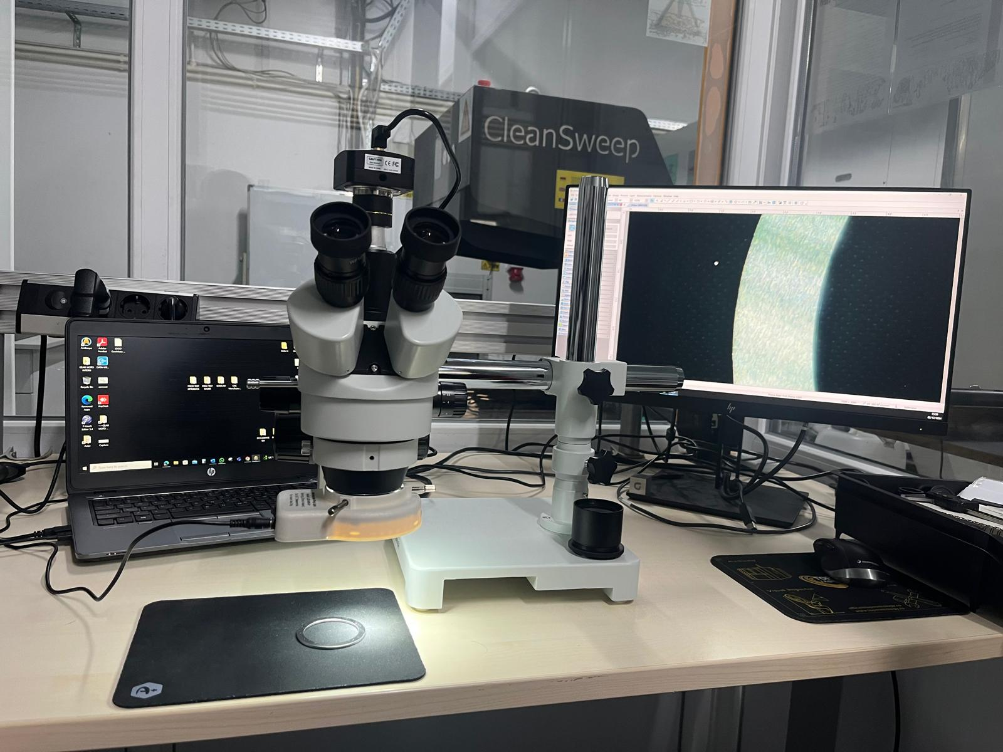
Visual inspection - AmScope
SM-3T-80S-M-EUL
7X-45X Trinocular LED Boom Stand Stereo Zoom Microscope + 1.3MP Digital Camera

Slide 5
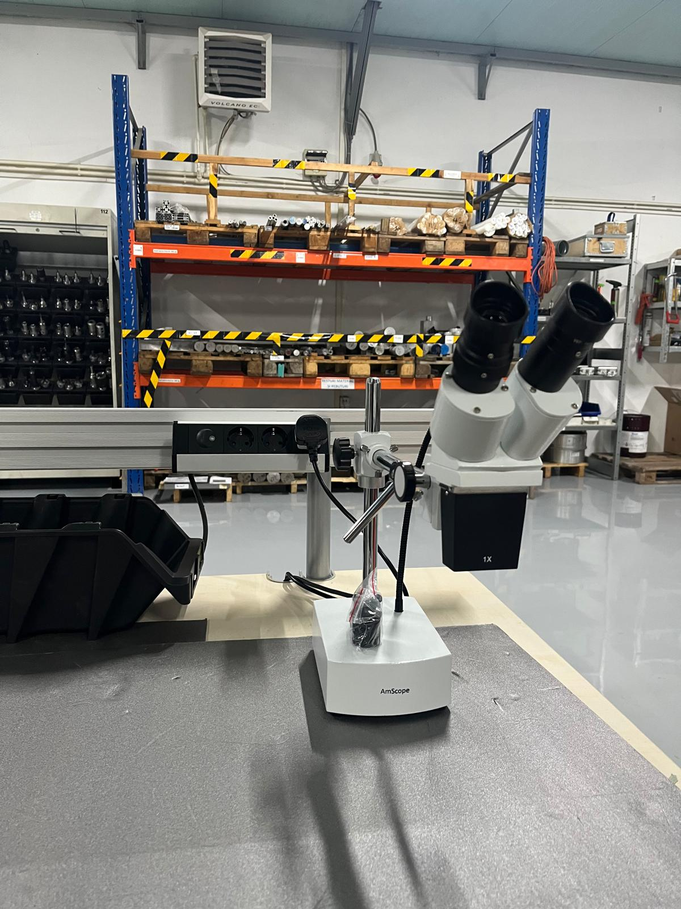
Visual inspection - AmScope
AmScope SE400 Series Compact Fixed-Lens Boom-Arm Stereo Microscope 10X-20X Magnification with Gooseneck LED Light

Slide 6
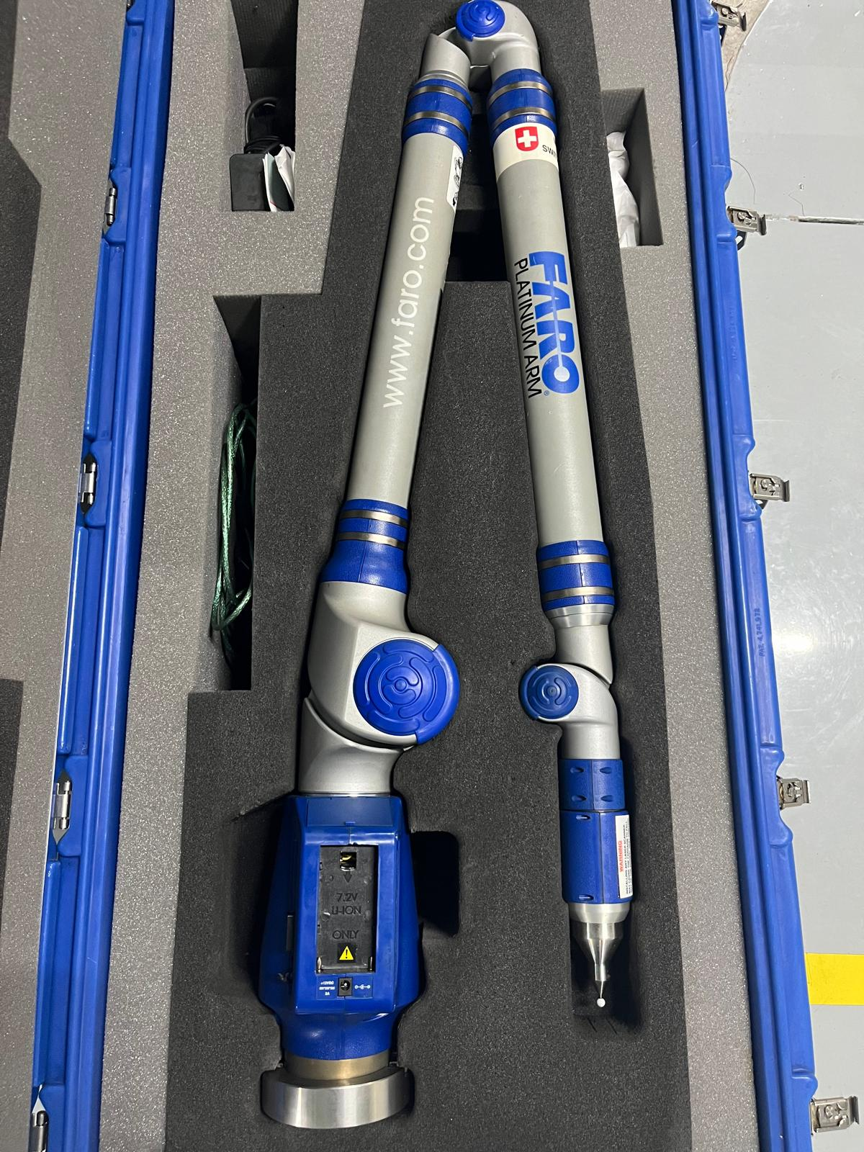
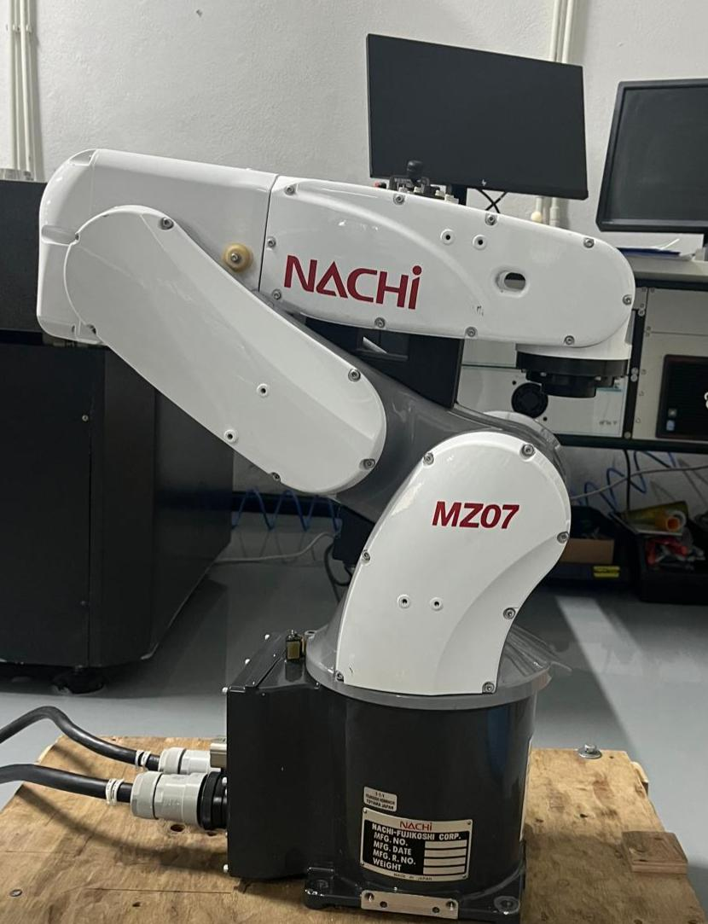
Faro Platinum Arm Model P08
Nachi Robot MZ07

Slide 7
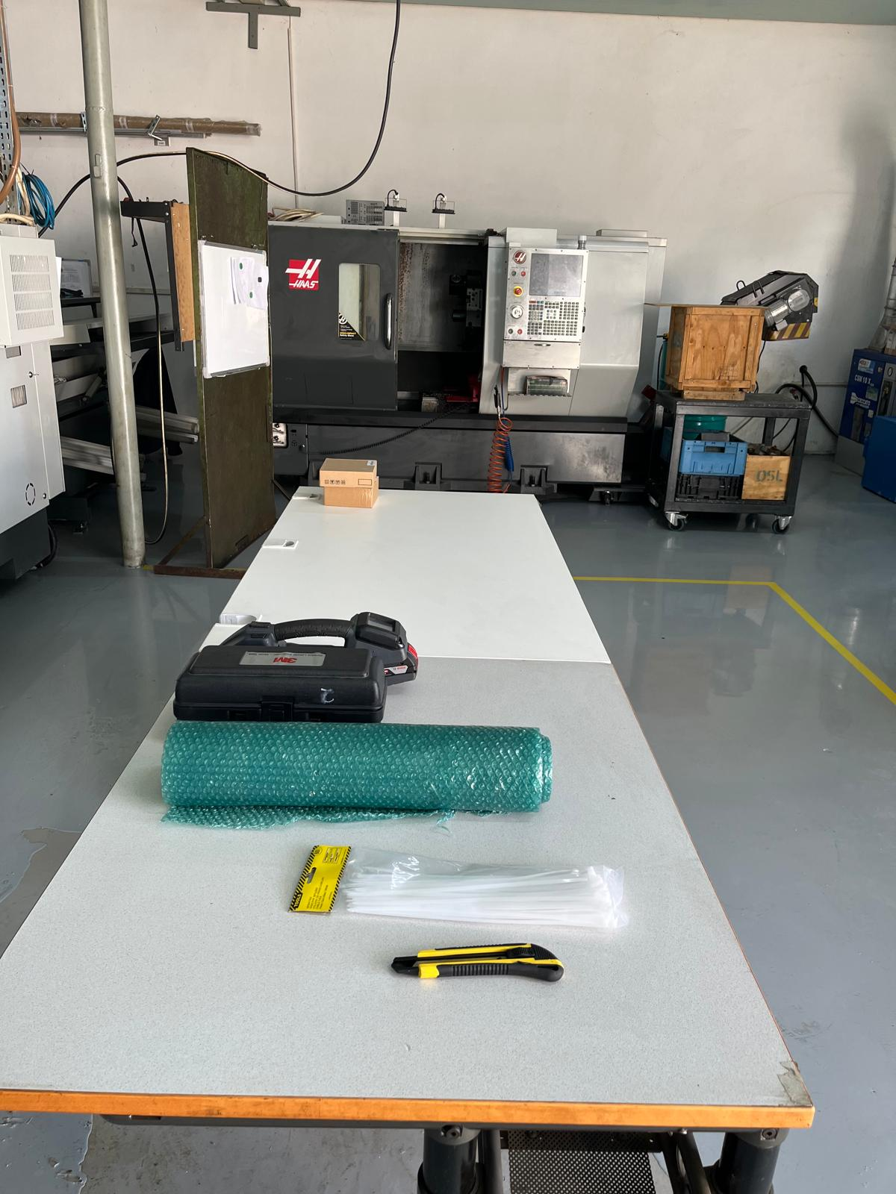
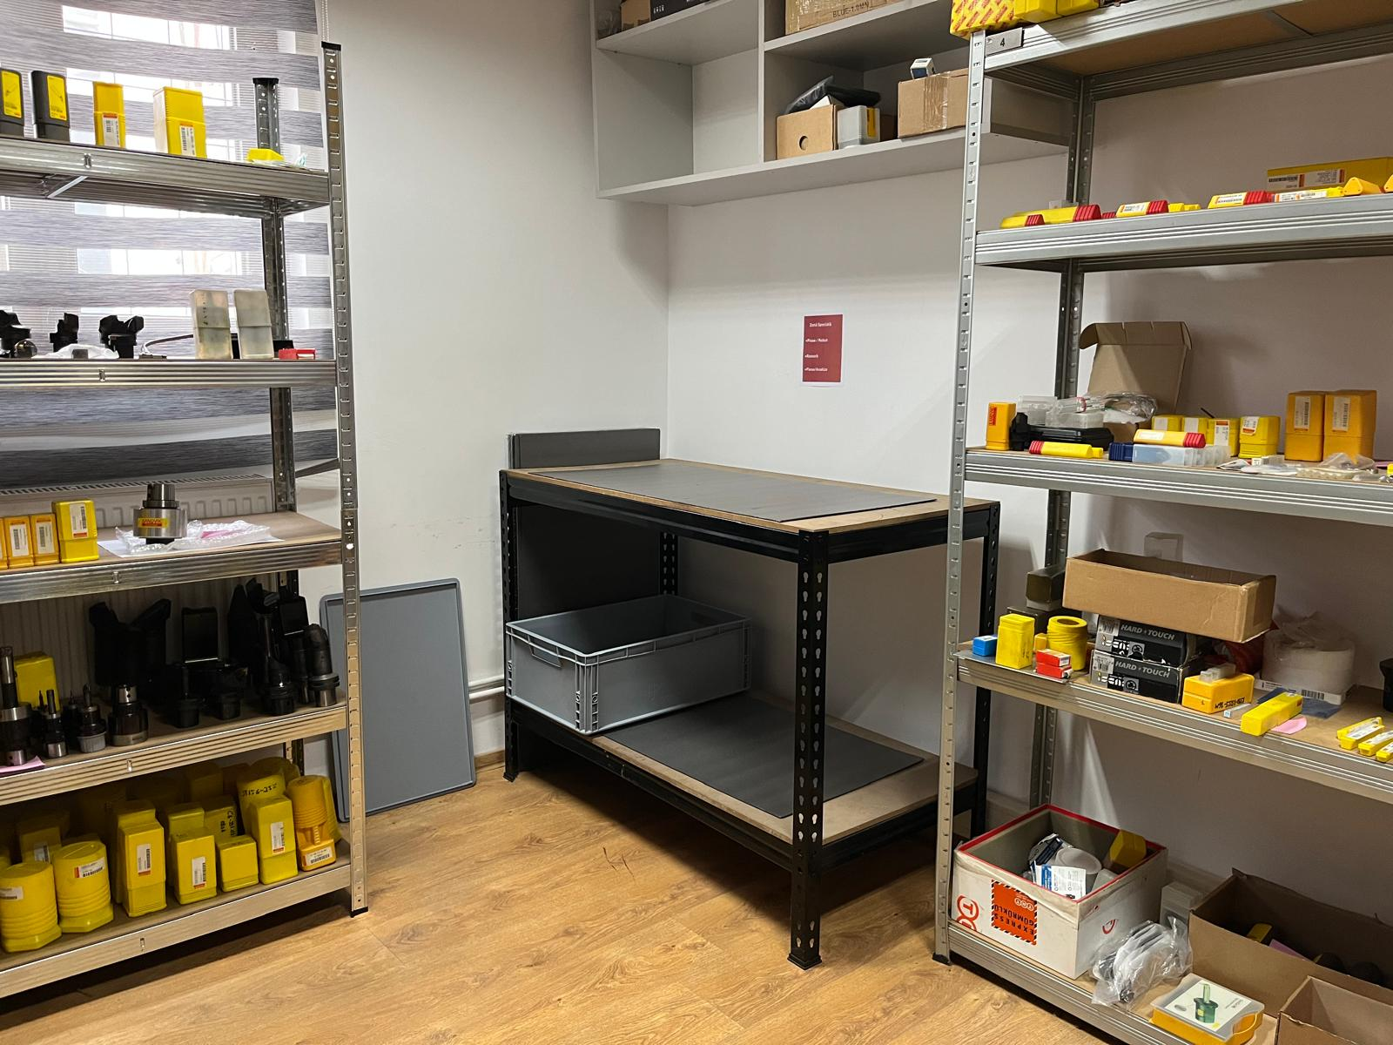
Space designated for final packaging, quality control, and storage of finished products.
Area built as a special place for scrap, rework, analysis parts.

Slide 8
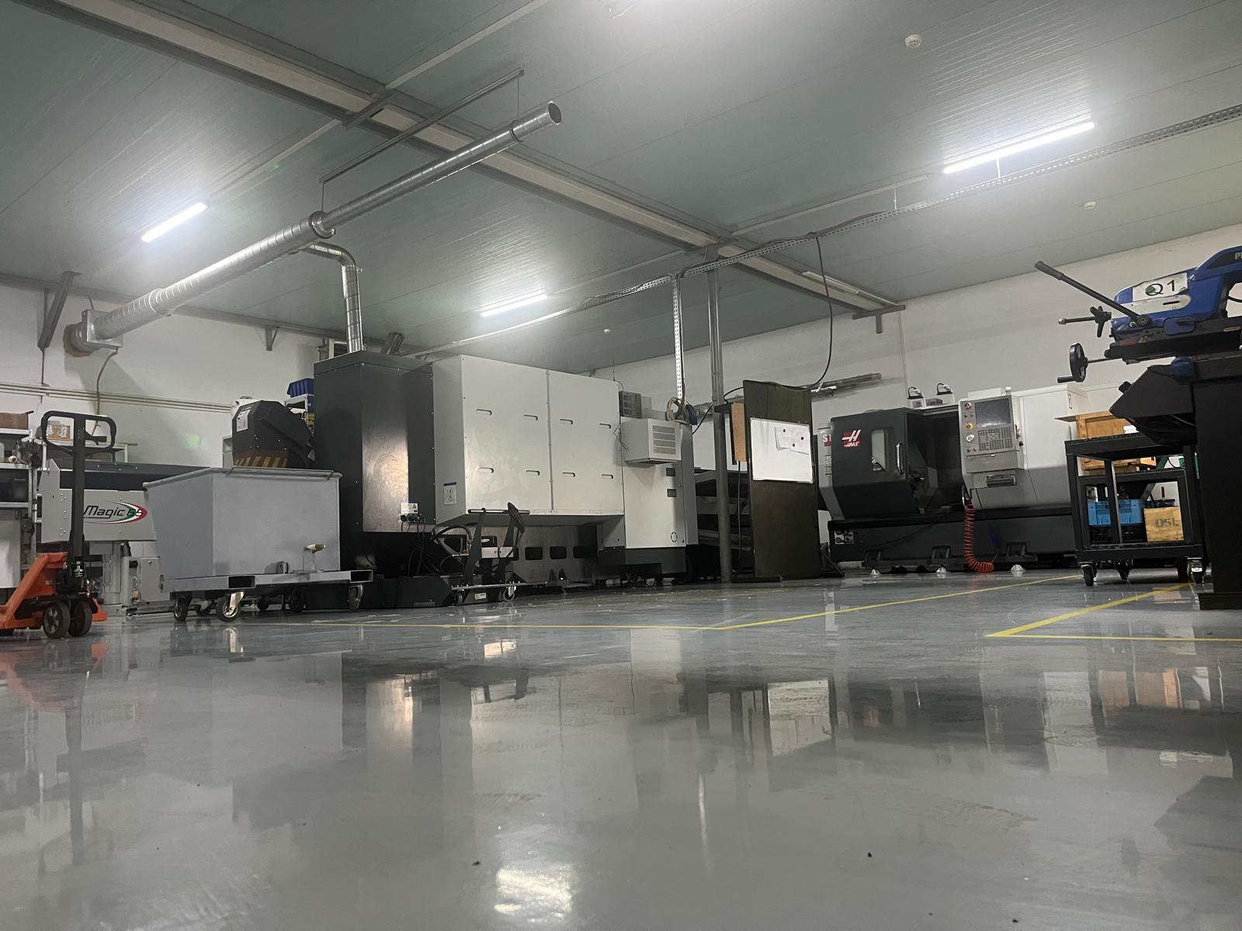
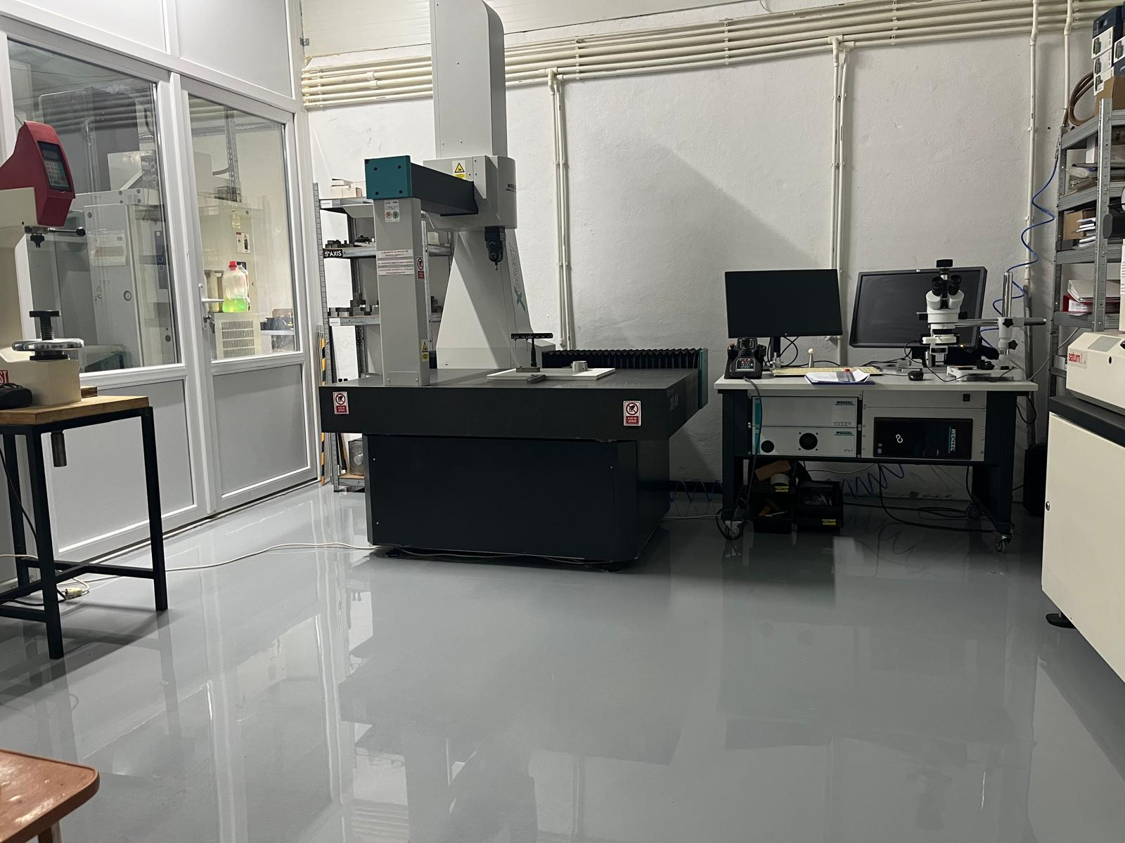
We have reorganized the production space and removed machines and tools that are out of use.
Relocation of out-of-use and obsolete devices to a designated storage area outside the measurement room.

Slide 9
Thank You

